Slide 1
Impact of Affordable Care Act Medicaid Expansions on Medicaid Revenue, Uncompensated Care and
Hospital Financial Position
Thomas C. Buchmueller
University of Michigan
Co-authors: Sayeh Nikpay (Vanderbilt), Helen Levy (Michigan)

Slide 2
The Affordable Care Act
The ACA is a comprehensive reform that aims to improve access to care, lower the growth in health spending and improve the quality of health care in the U.S.
The most important provisions relate to insurance coverage. They went into effect in January 2014.
  Raise Medicaid eligibility limit to 138% of FPL
  Introduce premium tax credits for purchasing private non-group insurance through new “Marketplaces”

Slide 3
State Medicaid Expansion Status, September 2016
ME
WA
VT
MT
ND
MN
NH*
OR
MA
SD
WI
NY
ID
MI
CT
RI
WY
PA
NJ
NE
IA*
OH
DE
NV
IL
IN
MD
CA
UT
CO
WV
VA
KS
MO
KY
DC
NC
Expansion Timeline
2014: 27 states
2015: 31 states
2016: 32 states
AZ
TN
NM
OK
AR
SC
MS
AL
GA
AK
TX
LA
FL
HI
Expansion (32 States including DC)
Non-Expansion (19 States)
Source: Kaiser Family Foundation

Slide 4
Early Evidence on Coverage Changes

Slide 5
Impact of Coverage Expansions
Large body of research suggests that increase in coverage will improve access to care as well as financial well-being.
  Early studies find evidence of both effects (Wherry and Miller 2016; Hu et al 2016).
Improved financial protection benefits providers as well.
  Each uninsured person generates ~ $900 of uncompensated hospital care per year (Garthwaite et al 2015)
  In 2013, hospitals provided ~$45 billion of uncompensated care (6% of expenditures).
Hospitals supported the ACA and continue to lobby for further Medicaid expansion.

Slide 6
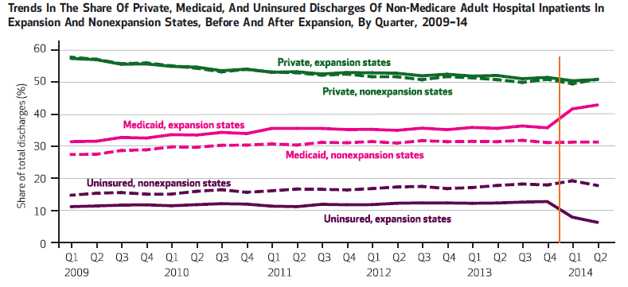
Source: Nikpay, Buchmueller and Levy, Health Affairs (2016)

Slide 7
Other Evidence
For-profit hospital chains reported decline in uncompensated care in expansion states, but not non-expansion states (Deleire et al 2014).
In Connecticut (an early expansion state) Medicare revenue increased and uncompensated care fell relative to other Northeastern states (Nikpay et al 2015).
In a larger set of expansion states, hospital uncompensated care fell by nearly one-quarter between 2013 and 2014 (Dranove et al 2016).

Slide 8

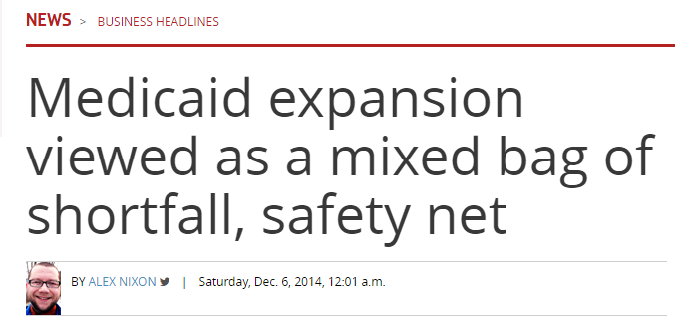
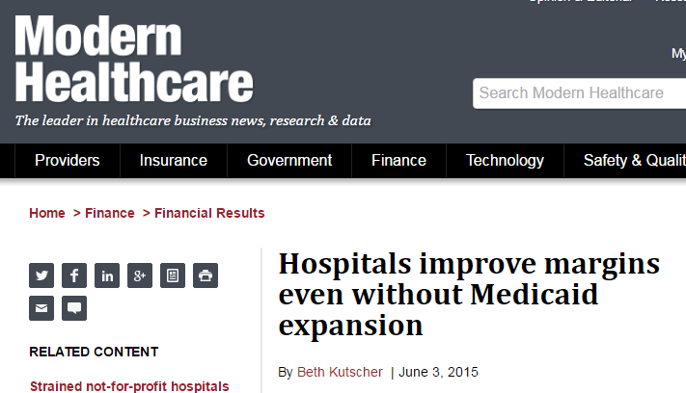

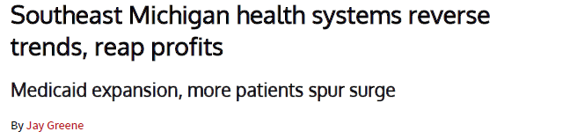

  Did these changes improve hospital finances?

Slide 9
Research Questions
What was the impact of the ACA Medicaid expansion on…
  Medicaid revenue?
  Hospital uncompensated care?
  Hospital financial position?
How do these effects vary among expansion states depending on the extent of expansion?

Slide 10
Outline
Background
  Medicaid, Uncompensated Care and Hospital Finances
  Heterogeneity among Expansion States
  Empirical Predictions
Data and Methods
  Data: The Medicare Cost Reports
  Data: State-level Hospital Discharge Data
  Diff-in-diff models
Results
Discussion and Conclusions

Slide 11
background

Slide 12
Hospital Uncompensated Care: Definition
Uncompensated care (UC) is care that a hospital provides but for which it is not paid.
It is the sum of charity care and bad debt.
  Because hospitals differ in the way that they define charity care and bad debt (and for a given hospital the definition may vary over time) we analyze total UC rather than its component pieces.

Slide 13
Uncompensated Care and Payer Mix
Uninsured and privately insured patients can generate uncompensated care (UC)
(1) UC = CX_{U} + CB_{P}X_{P}
  C = cost of care
  X_{i} = # of patients of payer type i (Uninsured, Private, Medicaid)
  B_{P} = Share of bill that private patients do not pay (0 < B_{P} < 1)
Note: Standard definitions of UC do not include the “Medicaid shortfall.”

Slide 14
Hospital Revenue
For simplicity, ignore Medicare and assume that hospitals collect no revenue from uninsured patients. Then a hospital’s revenue (R) will be
(2) R = P_{M}X_{M} + P_{P}(1-B_{P})X_{P}
  P_{i} = reimbursement rate for patients with insurance type i
  X_{i} = number of patients with insurance type i
There are large differences between P_{P} and P_{M}…

Slide 15
Differences in Payment Rates by Payer Source
2010-2012: Private health insurance rates were > 50% higher than Medicaid rates
Source: Selden et al, Health Affairs (2015)

Slide 16
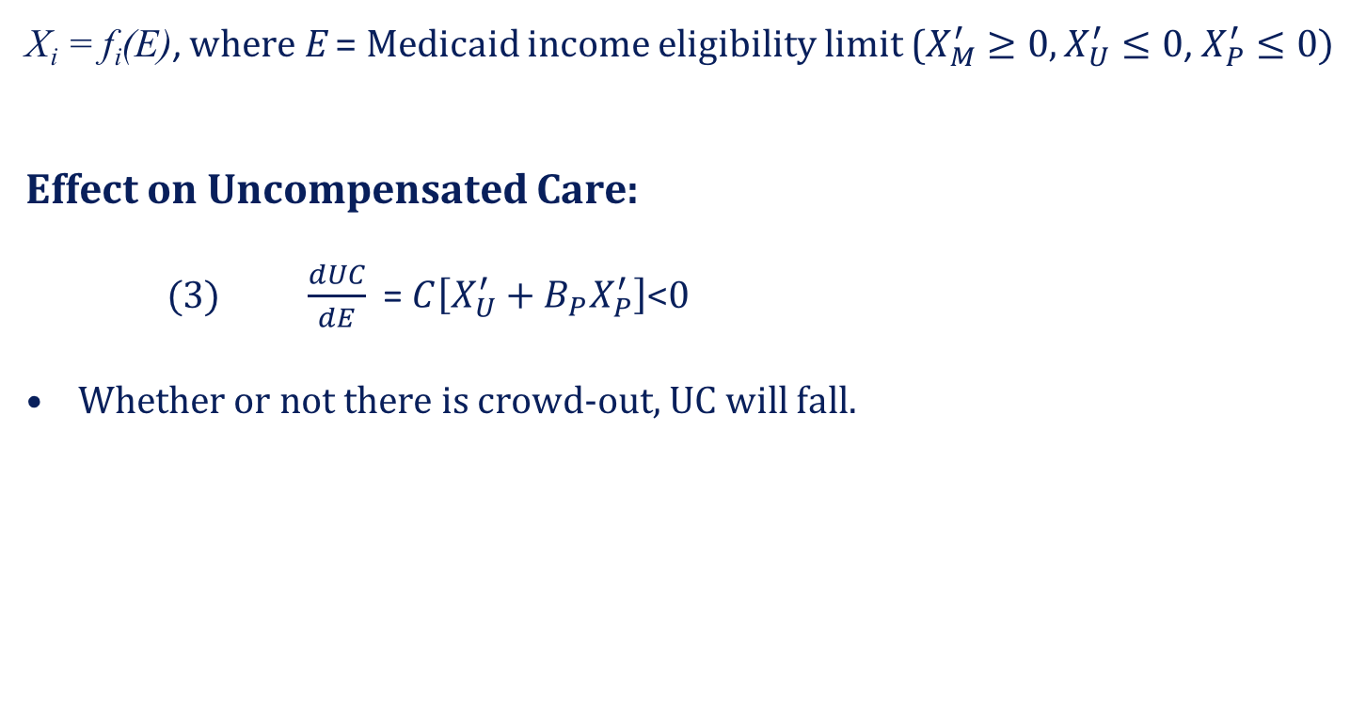
The Effect of Expanding Medicaid Eligibility
X_{i} = f_{i}(E), where E = Medicaid income eligibility limit ($X_{M}^{′}≥0, X_{U}^{′}≤0$, $X_{P}^{′}≤0)$
Effect on Uncompensated Care:
(3) $\frac{dUC}{dE}$ = $C\left[X_{U}^{′}+B_{P}X_{P}^{′}\right]$<0
Whether or not there is crowd-out, UC will fall.

Slide 17
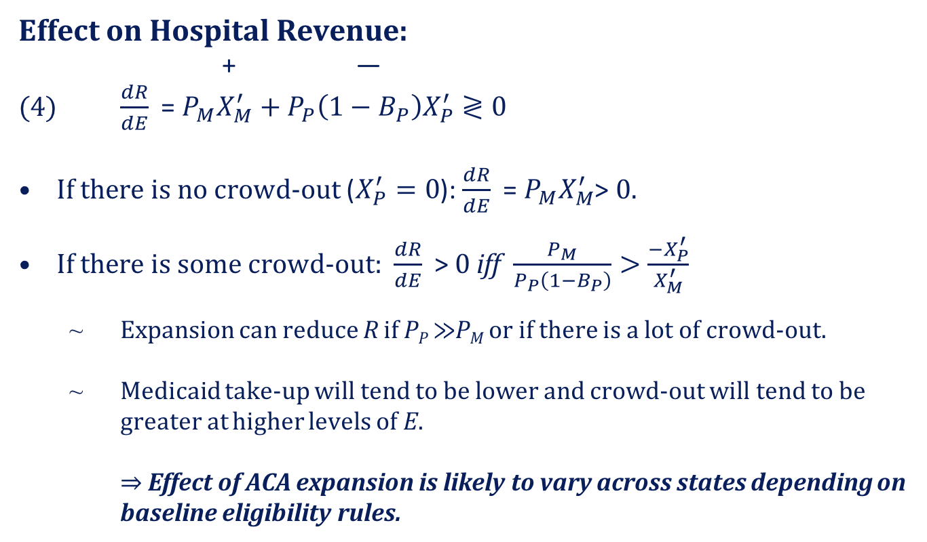
The Effect of Expanding Medicaid Eligibility
Effect on Hospital Revenue:
+ —
(4) $\frac{dR}{dE}$ = $P_{M}X_{M}^{′}+P_{P}\left(1−B_{P}\right)X_{P}^{′}≷0$
If there is no crowd-out ($X_{P}^{′}=0$): $\frac{dR}{dE}$ = $P_{M}X_{M}^{′}$> 0.
If there is some crowd-out: $\frac{dR}{dE}$ > 0 iff $\frac{P_{M}}{P_{P}\left(1−B_{P}\right)}>\frac{{−X}_{P}^{′}}{X_{M}^{′}}$
  Expansion can reduce R if P_{P} $≫$P_{M} or if there is a lot of crowd-out.
  Medicaid take-up will tend to be lower and crowd-out will tend to be greater at higher levels of E.
    $⇒$ Effect of ACA expansion is likely to vary across states depending on baseline eligibility rules.

Slide 18
Heterogeneity Among Expansion States
Pre-2010, income eligibility limit for children was > 138% of FPL in all states.
States had varying standards for adults. Most did not cover childless adults.
 | Pre-ACA Eligibility Limit > 100% FPL for…
Parents | Yes | Yes | No
Childless Adults | Yes | No | No
 | AZ, DC, DE, HI, MA, NY | CA, CO, CT, IL, MD, MN, NJ, RI | AR, AK, IA, IN, KY, MI, ND, NH, NM, NV, OH, OR, PA, WA, WV
“Minor Expansion”
States (7)
“Major Expansion”
States (23)

Slide 19
Baseline Coverage Rates by Expansion Status, Non-Elderly Adults in 2013
Source: Authors’ calculations using 2013 and 2014 American Community Survey

Slide 20
Changes in Coverage by Expansion Status
Source: Authors’ calculations using 2013 and 2014 American Community Survey

Slide 21
Empirical Predictions
Medicaid revenue should have increased in expansion states relative to non-expansion states.
  Largest gains in “major expansion” states
  Increase in “minor expansion” states relative to non-expansion
Uncompensated care expenditures should have fallen in expansion states relative to non-expansion states.
  Largest declines in “major expansion” states
  Decrease in “minor expansion” states relative to non-expansion states
Net income and operating margins (probably) should have increased in “major expansion” states relative to other states.
  No clear prediction about difference between ”minor expansion” and non-expansion states.

Slide 22
Data and methods

Slide 23
Data: Medicare Cost Reports
All Medicare-certified hospitals are required to file annual cost reports.
  Developed when hospitals were reimbursed on a cost-plus basis.
  Still main source of financial data used by CMS, Medpac, and financ. analysts.
Data on costs, volumes, revenue, uncompensated care expenditures and selected financial outcomes.
Although it is the best data available, there are important limitations:
  Not audited; does not comport with GAAP
  Does not provide separate revenue data by payer type (can’t observe revenue from private insurers)

Slide 24
Data: Medicare Cost Reports
Sample
5-year period from FY11 to FY15.
13,859 observations for 3,310 general acute care hospitals
Dependent Variables
Medicaid revenue
Uncompensated care expenditures
Net operating income (Total Revenue – operating expenses)
Operating margin (Net operating income/Total Revenue)
Time-varying Control Variables
Number of beds
Ownership status
Participation in 340B program
County unemployment rate

Slide 25
Pre-ACA Summary Statistics
 | Non-Expansion (N=4,235) |  | Minor Expansion (N=712) |  | Major Expansion (N=4,174)
 | Mean | SD | Mean | SD | Mean | SD
Medicaid Revenue ($M) | 19.93 | 37.45 | 53.49 | 72.05 | 27.76 | 43.6
Uncomp. Care ($M) | 9.56 | 15.22 | 11.91 | 17.44 | 9.93 | 14.07
Net Operating Inc. ($M) | 5.09 | 30.77 | -18.01 | 48.33 | -0.32 | 37.73
Operating Margin (%) | 0.02 | 0.18 | -0.05 | 0.11 | 0.01 | 0.14
For-Profit Ownership | 0.33 | 0.47 | 0.11 | 0.31 | 0.18 | 0.38
Public Ownership | 0.23 | 0.42 | 0.10 | 0.29 | 0.10 | 0.31
Hospital Beds | 180 | 243 | 245 | 226 | 201 | 168
County Unemp. Rate (%) | 7.70 | 2.33 | 7.84 | 1.87 | 8.69 | 2.36
340B Program | 0.30 | 0.46 | 0.42 | 0.49 | 0.30 | 0.46

Slide 26
Data: HCUP Fast Stats Data
One limitation of the cost report data is no information on the number of private patients or private revenue.
To provide insight on how payer mix was changing, we analyze state-level discharge data from AHRQ’s HCUP Fast Stats program
  Share of non-elderly discharges by payer source
  Total discharges and by type of care (medical, mental, surgical)
2013 and 2014 data are available for 17 non-expansion, 11 major expansion and 4 minor expansion states. (N = 296)
These data allow us to test for crowd-out in expansion states relative to the trend in non-expansion states.

Slide 27
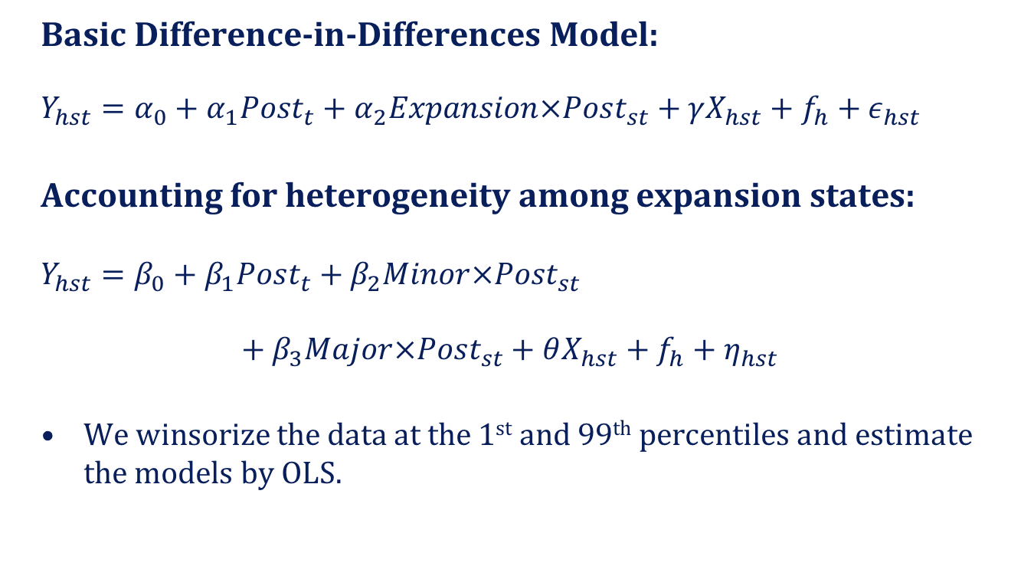
Regression Models
Basic Difference-in-Differences Model:
$$Y_{hst}=α_{0}+α_{1}Post_{t}+α_{2}Expansion×Post_{st}+γX_{hst}+f_{h}+ε_{hst}$$
Accounting for heterogeneity among expansion states:
$$Y_{hst}=β_{0}+β_{1}Post_{t}+β_{2}Minor×Post_{st}$$
$+ β_{3}Major×Post_{st}+θX_{hst}+f_{h}+η_{hst}$
We winsorize the data at the 1st and 99th percentiles and estimate the models by OLS.

Slide 28
Empirical Issues
Issue: Because FY does not necessarily coincide with the calendar year, data for 2014 represents a mix of “pre” and “post.”
Response: In main models, we define Post as the share of the year in which the ACA coverage provisions were in effect.
  As an alternative approach, we limited the sample to hospitals with FYs starting in January. The results are basically the same.
Issue: DD model estimates the effect of Medicaid expansion relative to the counterfactual implied by the trend in non-expansion states. This relies on the parallel trends assumption.
Response: We compare trends by expansion status in “pre” period.

Slide 29
No Evidence of Differential Pre-Trends
 | Medicaid Revenue | Uncomp. Care | Net Operating Income | Operating Margin
Trend | -0.376 (0.846) | 0.339 (0.284) | -0.781 (0.681) | -0.010** (0.003)
Trend x Minor Expansion | 0.247 (2.035) | 0.289 (0.683) | -1.815 (1.639) | 0.000 (0.007)
Trend x Major Expansion | 0.639 (1.213) | 0.011 (0.407) | 0.325 (0.977) | 0.004 (0.004)
Number of Observations | 9,075 | 9,075 | 9,075 | 9,075
R² | 0.044 | 0.002 | 0.0326 | 0.0142
Notes: Data are for the years 2011 to 2013.

Slide 30
results

Slide 31
Results: Medicaid Revenues
 | (1) | (2) | (3)
 | $million | $million | ln($million)
Post | -0.410 (0.546) | -0.336 (0.539) | -0.034 (0.022)
Post x Expansion | 6.737** (1.099)
Post x Major Expansion |  | 7.379** (1.136) | 0.293** (0.034)
Post x Minor Expansion |  | 4.202** (1.207) | 0.137** (0.038)
Number of observations | 13,859 | 13,859 | 13,859
Number of hospitals | 3,310 | 3,310 | 3,310
R² | 0.096 | 0.085 | 0.091
Notes: ** p < 0.01; * 0.01 < p < 0.05

Slide 32
Results: Uncompensated Care Expenditures
 | (1) | (2) | (3)
 | $million | $million | ln($million)
Post | 0.454 (0.316) | 0.415 (0.316) | 0.107* (0.047)
Post x Expansion | -3.564** (0.465)
Post x Major Expansion |  | -3.903** (0.481) | -0.484** (0.067)
Post x Minor Expansion |  | -2.223** (0.357) | -0.298** (0.059)
Number of observations | 13,859 | 13,859 | 13,859
Number of hospitals | 3,310 | 3,310 | 3,310
R² | 0.071 | 0.070 | 0.071
Notes: ** p < 0.01; * 0.01 < p < 0.05

Slide 33
Results: Net Operating Income and Margin
 | (1) | (2) | (3) | (4)
 | Net Income $million | Net Income $million | Operating Margin | Operating Margin
Post | 0.468 (1.128) | 0.550 (1.119) | -0.008 (0.006) | -0.008 (0.006)
Post x Expansion | 1.538 (1.193) |  | 0.013* (0.006)
Post x Major Expansion |  | 2.257 (1.158) |  | 0.017** (0.006)
Post x Minor Expansion |  | -1.299 (2.195) |  | -0.0003 (0.006)
Number of observations | 13,859 | 13,859 | 13,859 | 13,859
Number of hospitals | 3,310 | 3,166 | 3,310 | 3,310
R² | 0.008 | 0.010 | 0.057 | 0.061
Notes: ** p < 0.01; * 0.01 < p < 0.05

Slide 34
Robustness and Sensitivity Checks
We obtain similar results when we
  Limit the sample to hospitals with FYs ending in Q4
  Drop observations where FY straddles 1/14
  Drop “early expansion” states
  Limit the sample to hospitals reporting in all years

Slide 35
Changes in Inpatient Payer Mix, 2013 to 2014
 | (2) | (4) | (6)
ALL DISCHARGES | Uninsured Share | Medicaid Share | Private Share
Post | -0.015 (0.008) | 0.003 (0.012) | 0.012 (0.016)
Major Expansion | -0.038** (0.008) | 0.027** (0.010) | 0.012 (0.014)
Minor Expansion | -0.084** (0.013) | 0.113** (0.016) | -0.029 (0.022)
Post x Major Expansion | -0.054** (0.013) | 0.081** (0.017) | -0.026 (0.022)
Post x Minor Expansion | -0.014 (0.021) | 0.035 (0.027) | -0.020 (0.036)
Notes: ** p < 0.01; * 0.01 < p < 0.05; N = 296

Slide 36
Changes in Inpatient Payer Mix, 2013 to 2014
 | (2) | (4) | (6)
SURGICAL DISCHARGES | Uninsured Share | Medicaid Share | Private Share
Post | -0.015 (0.008) | -0.001 (0.009) | 0.016 (0.013)
Major Expansion | -0.032** (0.007) | 0.037** (0.008) | -0.004 (0.011)
Minor Expansion | -0.065** (0.012) | 0.108** (0.013) | -0.043* (0.018)
Post x Major Expansion | -0.043** (0.012) | 0.082** (0.013) | -0.040* (0.018)
Post x Minor Expansion | -0.007 (0.021) | 0.062** (0.023) | -0.055 (0.031)
Notes: ** p < 0.01; * 0.01 < p < 0.05; N = 296

Slide 37
Trends in ED Visits by State Expansion Status
Source: Buchmueller, Freedman, Levy and Nikpay (2016)

Slide 38
Trends in ED Payer Mix by State Expansion Status
Source: Buchmueller, Freedman, Levy and Nikpay (2016)

Slide 39
Summary and Conclusions
Hospitals were major supporters of ACA in general and Medicaid expansion in particular.
  ACA expected to reduce the burden of uncompensated care.
Early (fragmentary) evidence indicated immediate shifts in payer mix and declines in uncompensated care.
Media reports suggest that this has not translated to increased income for hospitals.

Slide 40
Summary and Conclusions
We find further evidence that the ACA Medicaid expansion has reduced uncompensated care.
  Effect was largest in ”major expansion” states, but…
  UC also fell in “minor expansion” states relative to non-expansion states, despite similar coverage gains
  Result has to do with difference between Medicaid and private insurance

Slide 41
Summary and Conclusions
Because Medicaid pays hospitals less than private insurance, “crowd-out” reduces revenue and net income
  In our context, crowd-out comes from lower growth in private coverage in expansion states
In minor expansion states, there was substantial crowd-out relative to non-expansion states.
  Fall in uncomp. care offset by ”Medicaid shortfall” (e.g., Arizona)
In major expansion states, there was some crowd-out, but still a significant increase in overall coverage.
  Net positive effect on operating margins (e.g., SE Michigan)

Slide 42
Policy Implications
This research is important not only for understanding what happened in expansion states, but for projecting the effects of further expansion.
Since non-expansion states are more similar to “major expansion” states, our results suggest that if they expand their hospitals will see an improvement in their bottom lines.

Slide 43
Related Policy Issues
ACA calls for reductions in Disproportionate Share Hospital (DSH) payments, which compensated hospitals for treating uninsured patients.
Our results indicate that a decline in uninsured patients does not necessarily translate to a financial windfall. Care should be taken to evaluate changes in the distribution of uncompensated and “less compensated” care.
Tax-exempt status of non-profit hospitals is justified on the basis of their provision of “community benefits,” including charity care. Declines in uncompensated care may lead to further scrutiny of the rationale for this tax preference.

